Slide 1

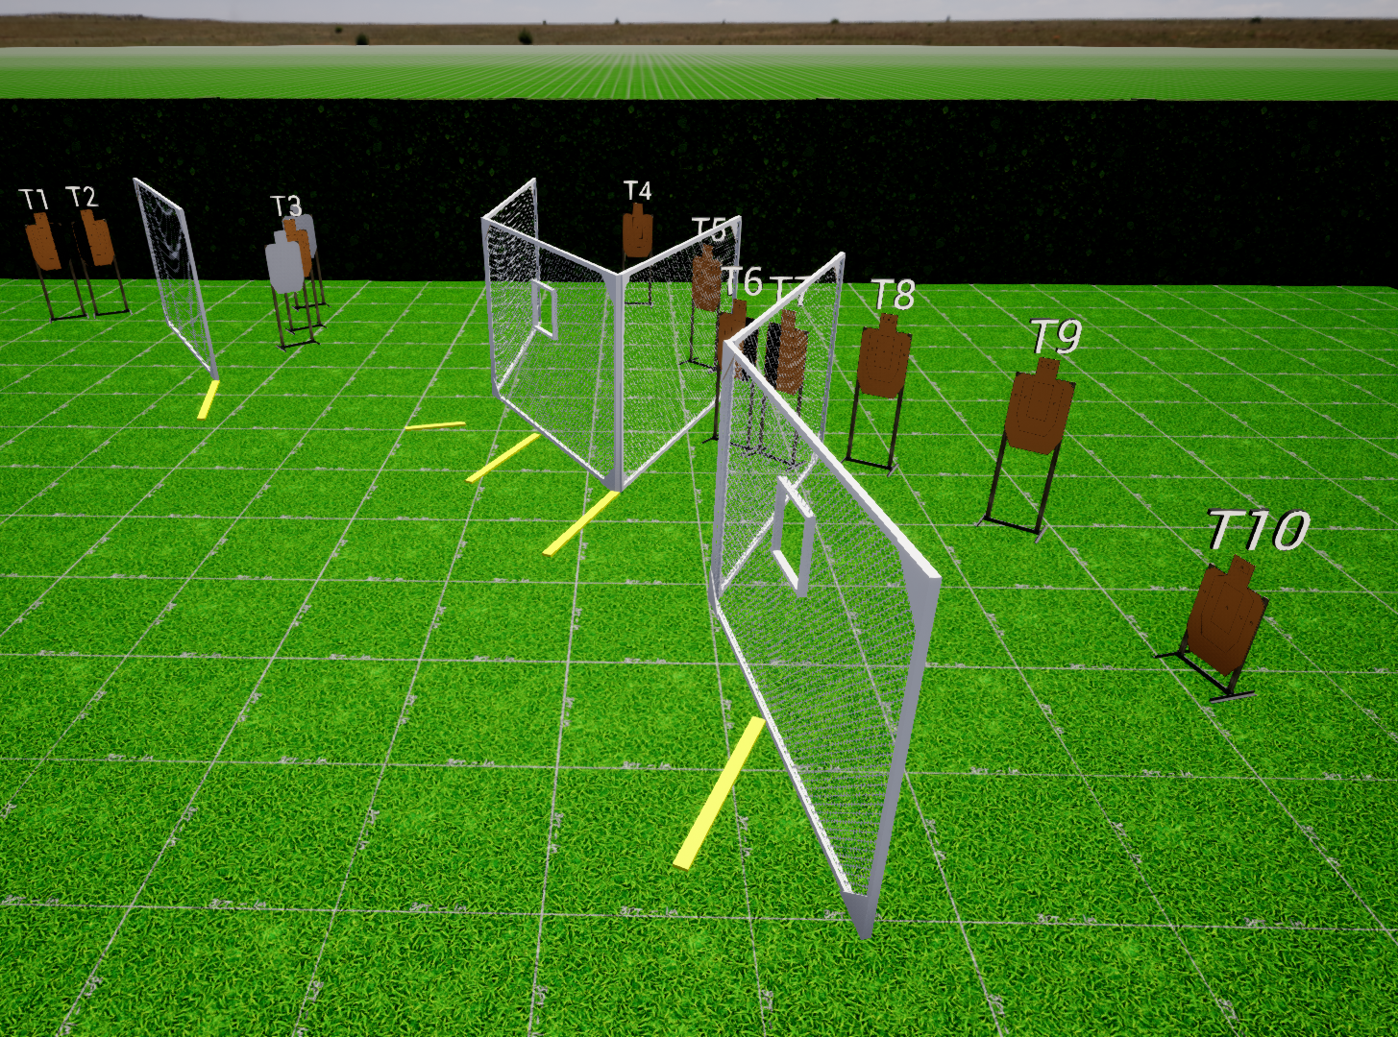
 | Interlake Sporting Association SUR, B Stage: Ignore The Man Behind The Curtain Course Designer: Marcel Englmaier
START POSITION: Toes touching starting fault line. Handgun: Loaded and holstered, wrists below belt. PCC: Stock on belt, muzzle pointed downrange. |  | STRINGS: 1 SCORING: Unlimited ROUND COUNT: 10 START-STOP: Audible - Last shot
STAGE PROCEDURE: At the start signal, engage T3 in the open, then engage all remaining targets from available positions of cover. Reload required between first and last shot
P1
Start
P2
P3
P4

